Slide 1
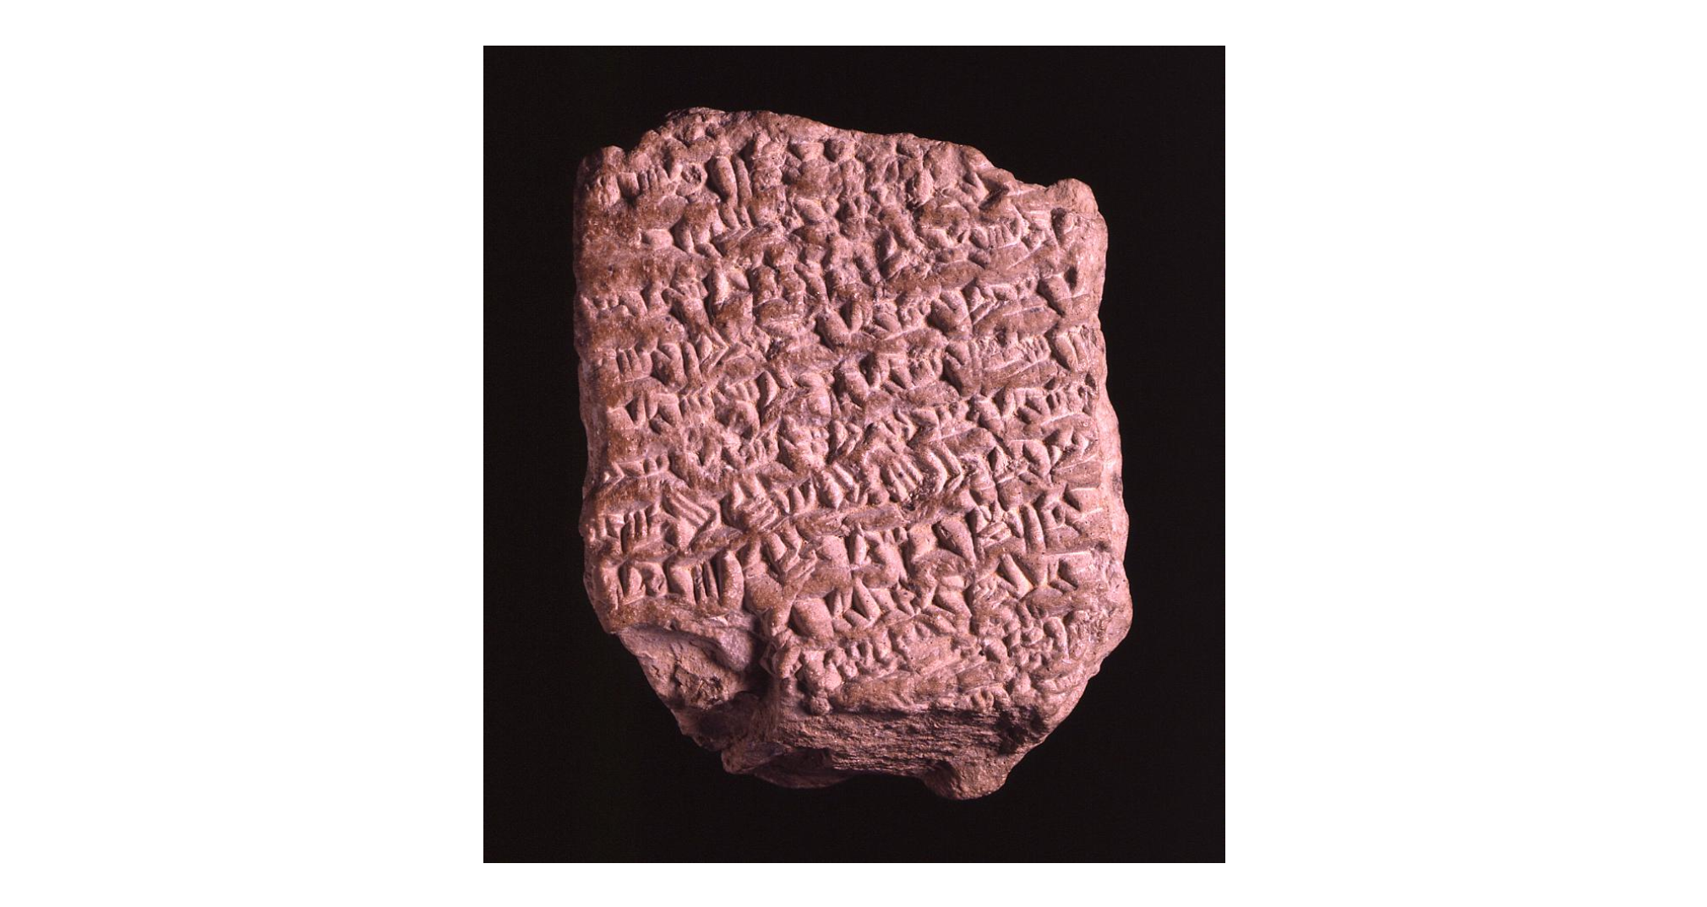
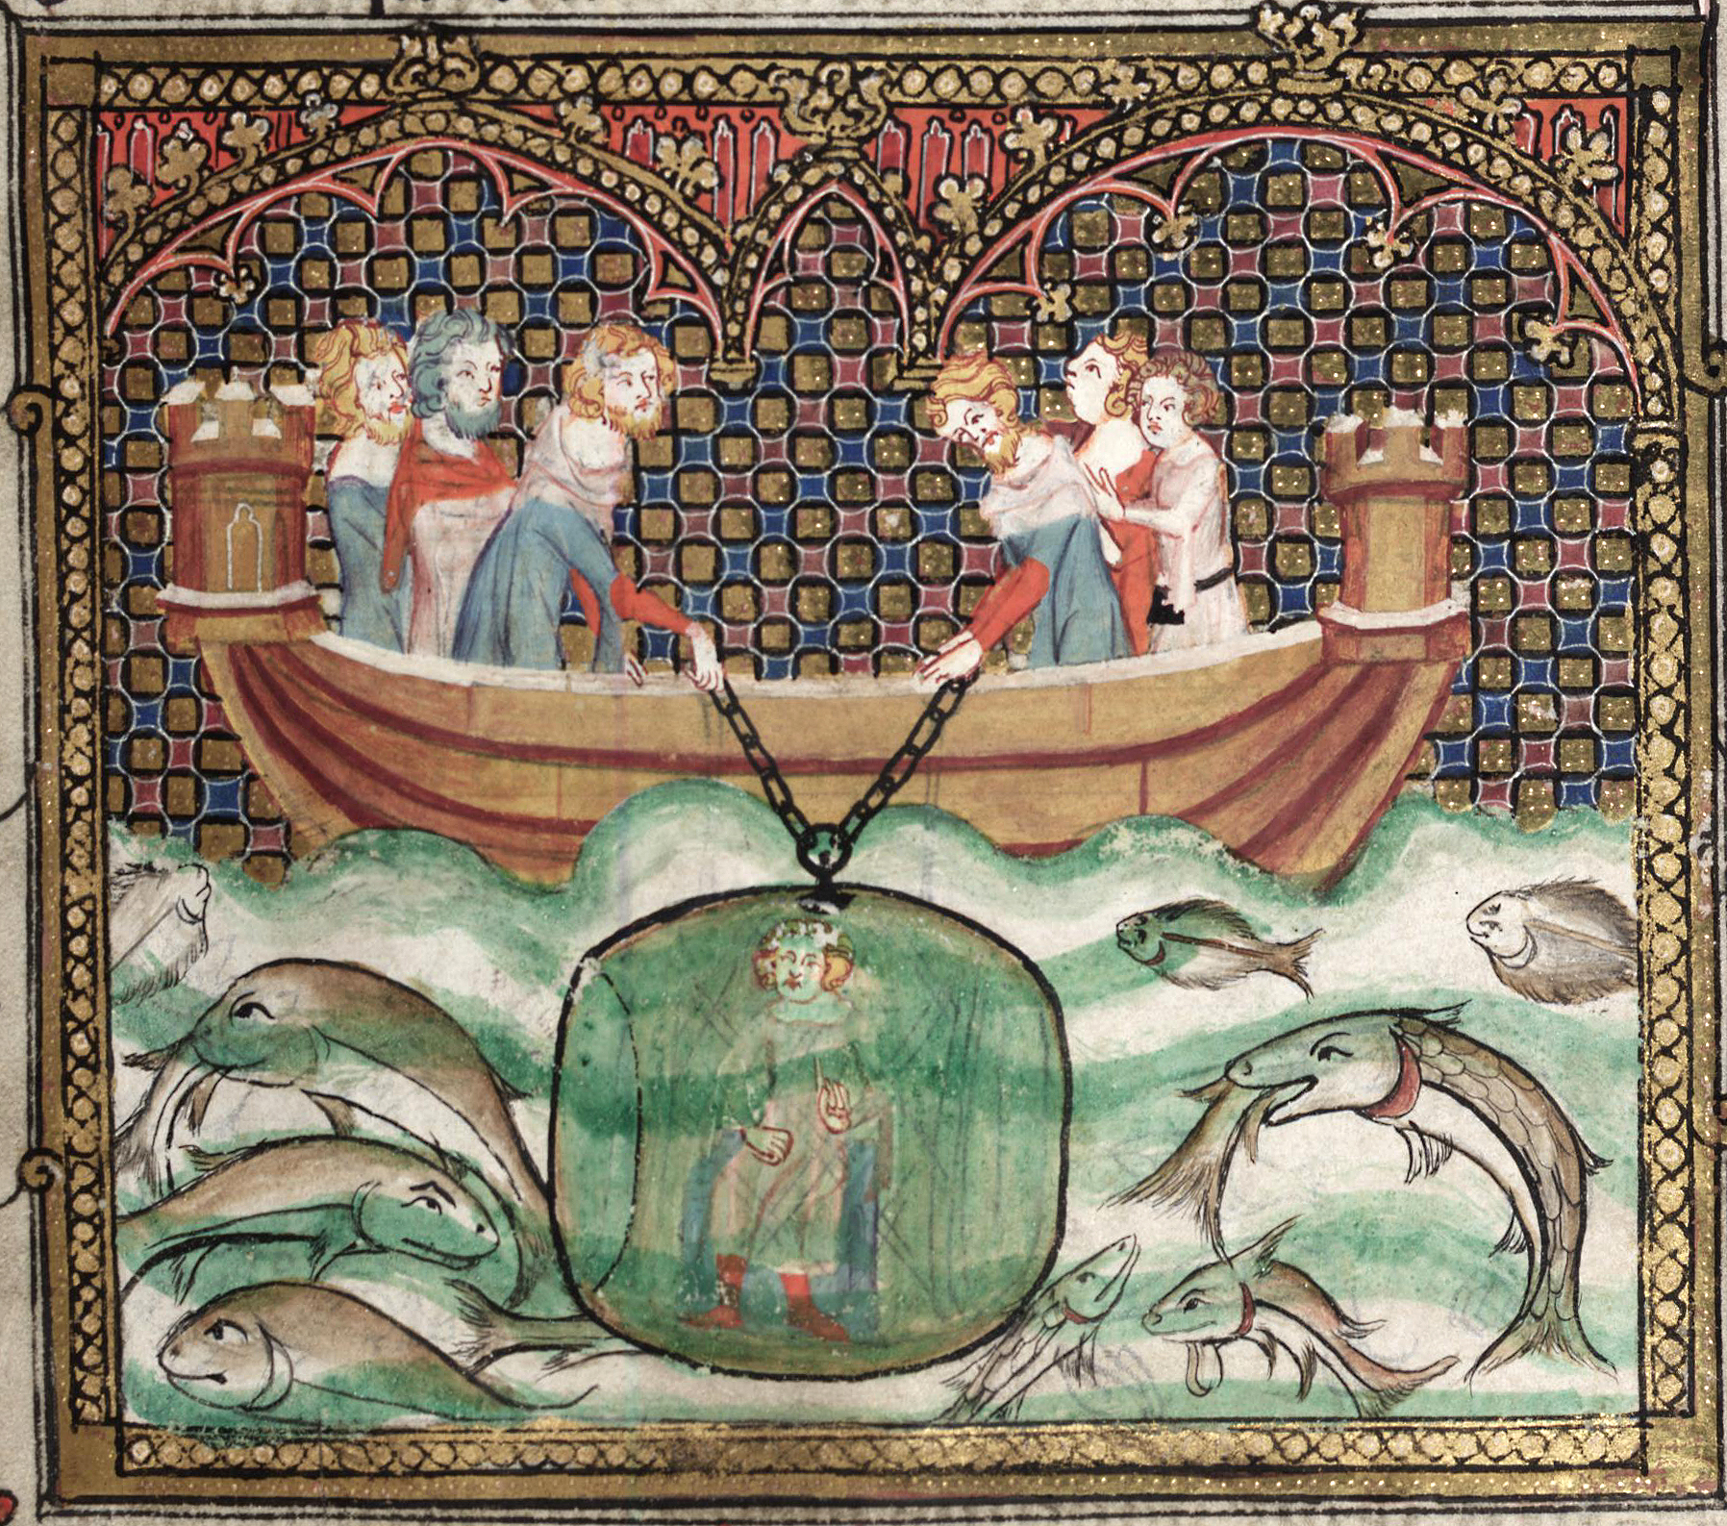
Week 5A – The Return to Babylon; The Mass Wedding at Susa and the Opis Mutiny; The Death of Alexander
Babylonian Astronomical Diary, mentioning Alexander’s death (British Museum)
MS Illustration, Roman d’Alexandre (Oxford, 12th Cent.)

Slide 2
Events: Summer 325 – 323 BCE
*After the troops’ refusal to march any further at the Hyphasis river (Summer 326), Alexander returned to the Hydaspes and prepared the fleet to sail south to the ocean (Autumn 326).
*The passage of the army down the Indus river system actually took almost a full year; a series of excessively violent campaigns against the Malli and Oxydracae, the independent kings Sambus and Musicanus, and others. Alexander’s near death experience in the Mallian campaign.
*The whole region was subdued with a zero-tolerance policy, and by July 325 the army was reformed at Patala, while Nearchus and the fleet explored the lower Indus delta.
*In September 325, Alexander set out with the army by land, on a dangerous route through the Gedrosian desert.
*October 325, Nearchus sets sail with the fleet, following the coast up to the Persian gulf, meeting A. in Carmania before proceeding to Susa.
*A column was dispatched earlier under Craterus (3 phalanx battalions, A.’s newly acquired elephants, and veterans deemed unfit for service), taking an easier road to Carmania.

Slide 3
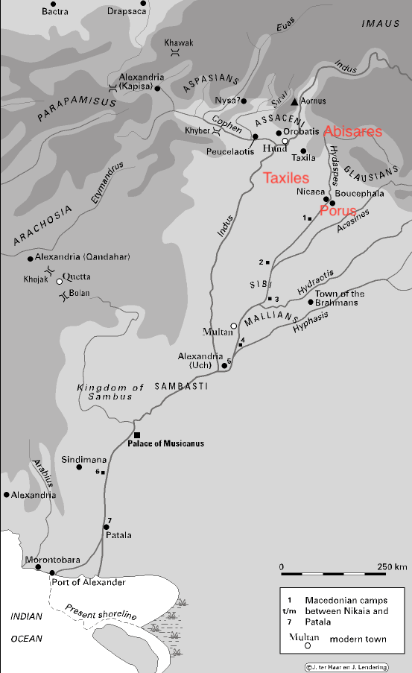

Slide 4
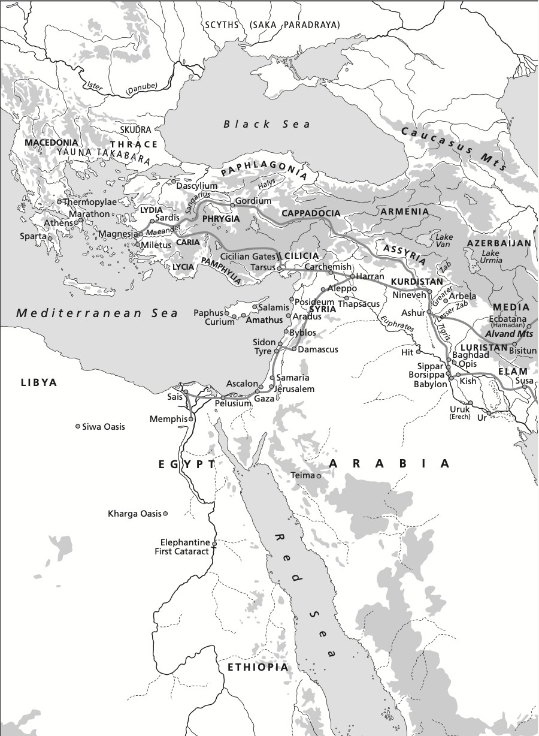
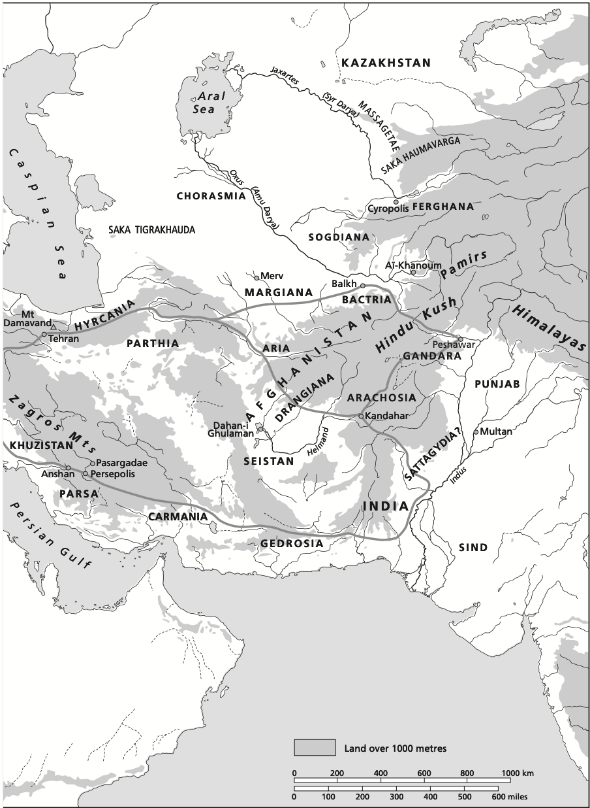

Slide 5
Events: Summer 325 – 323 BCE
*The march through Gedrosia was dangerous: despite its reduced size, the army and camp followers were very large, making water supply a major concern.
*There was also fighting along the way: first against the independent Oreitae in eastern Baluchistan. A. was in a rush to secure the territory and make sure of the safety of the fleet, leaving Leonnatus behind to keep control.
*~End of October 325, Alexander takes to the road through Gedrosia. Once again inspired by mythical/historical precedents (the legendary queen Semiramis and Cyrus the Great were both believed to have lost armies here: Arrian 6.24.2-3).
*The march through Gedrosia was certainly costly: Diodorus says A. lost “many” of his soldiers, and Plutarch (66) says that he lost ¾ of his troops. This is highly unlikely based on later numbers, and indeed the travel was probably hardest on the non-fighting camp followers.
*Bosworth notes that the most vivid accounts of the sufferings on the march probably derive from Nearchus, who was cruising along with the fleet!
Q) Even if it was not a military calamity, what effect might this march have on Alexander’s followers? The military objectives were minor, so why not take a longer, safer route?

Slide 6
Events: Summer 325 – 323 BCE
*After the first 60 days march, A. and the army arrived in the Gedrosia capital of Pura. There he received supplies sent for from neighboring provinces, and began to receive reports of some minor rebellions, and more disturbingly, that various satraps in the central regions of the empire were acting a little too independently.
*Winter 324: After meeting with Nearchus in Carmania, A. proceeded to Persepolis and Pasargadae.
*Presumably, with Alexander far to the east for several years, some satraps had started to assume he would never return. When he did, there was a general purge of several Persian satraps (only Atropates in Media and Phrataphernes in Parthia, along with his own father-in-law Oxyartes proved their loyalty).
*Their replacements would be Macedonians, notably Peucestas, who had risen to a prominent position, was appointed to the satrapy of Persis.
Plutarch (68): “But the increasing difficulties of his march back, his wound among the Malli, and the losses in his army, which were reported to be heavy, led men to doubt his safe return, inclined subject peoples to revolt, and bred great injustice, rapacity, and insolence in the generals and satraps whom he had appointed. In a word, restlessness and a desire for change spread everywhere.”

Slide 7
Events: Summer 325 – 323 BCE
*A. also executed three Macedonian generals (Cleander, Sitalces, and Heracon) who had been in Media, for abuse of their position and oppression of the population (Arrian 6.27.3-5): “in Alexander’s empire, oppression of the ruled by the rulers was not tolerated.”
-> Arrian’s remark might be something of an exaggeration, but there does seem to be a distinct difference between Alexander’s treatment of resistance and his policy toward subject populations.
*At Pasargadae, a commonly reported anecdote of Alexander’s anger at the desecration of Cyrus the Great’s tomb (Arrian 6.29; Plutarch 69); Plutarch adds that he ordered the Persian inscription to be copied in Greek as well:
Ὦ ἄνθρωπε, ὅστις εἶ καὶ ὅθεν ἥκεις, ὅτι μὲν γὰρ ἥξεις, οἶδα, ἐγὼ Κῦρος εἰμὶ ὁ Πέρσαις κτησάμενος τὴν ἀρχήν. μὴ οὖν τῆς ὀλίγης μοι ταύτης γῆς φθονήσῃς ἣ τοὐμὸν σῶμα περικαλύπτει.
”Man, whoever you are and wherever you come from, because you will come, I know; I am Cyrus and I acquired an empire for the Persians. So do not begrudge me this little earth which covers my body”.
*Plutarch (69) says these words reminded Alexander of the mutability and uncertainty of life.

Slide 8
Events: Summer 325 – 323 BCE
*Arrian (7.1) tells us “a longing seized” Alexander to sail down the Euphrates to the Persian gulf, with others reporting that he planned to conquer North Africa (Carthage), the Black sea region, or even Italy “because he was beginning to feel some anxiety about the growing power of Rome”.
*In Persis, the Indian philosopher Calanus, who had been accompanying Alexander died. Note the long digression in Arrian (7.2-3); a proto-Stoic?
*March 324: Alexander arrives in Susa, as does Nearchus.
Mass Marriage at Susa:
Alexander married Stateira, daughter of Darius III (sometimes, confusingly, called Barsine), and according to Aristobulus (Arrian 7.4.4), also Parysatis the daughter of Artaxerxes III.
Hephaestion to Stateira’s sister, Drypetis
Leading Macedonians (Craterus, Ptolemy, Perdiccas, Eumenes, Nearchus, Seleucus) were married to the daughters of prominent Persian satraps (only Seleucus’ marriage to Apame did not end in divorce!) along with 80 more of the companions.
The weddings were a public celebration, and held according to Persian custom.
Arrian (7.4.8) states that the 10,000 Macedonians who had already married ‘Asian’ women were registered and given wedding gifts at the occasion.

Slide 9
Events: Summer 325 – 323 BCE
Q) What are the symbolic implications of the weddings at Susa?
Q) What are the concrete political ramifications?
*The weddings at Susa showed Alexander’s generosity to his army: he decided to pay off all of the debts of his men, which required a registry and at first caused friction.
*Arrian relates that after some initial reluctance, “it is said that” some 20,000 talents were paid out to indebted soldiers (Diodorus 17.109.2 = 10,000, likewise Plutarch, except he states 9,870 talents were paid to the wedding guests).
*It brings up some interesting questions: How were his soldiers so in debt, and to whom? And why pay soldiers’ debts instead of a universal gift?
->Diodorus seems to conflate the timing of the weddings and gifts at Susa and the mutiny at Opis, but this occurred several months later in the summer of 324!
Q) Diodorus is mistaken, but what’s the connection?

Slide 10
Events: Summer 325 – 323 BCE
*It is also at Alexander’s time in Susa that the epigoni, the 30,000 cadets from the eastern provinces who were trained in and equipped for Macedonian phalanx warfare, arrive and cause some contention with the Macedonian troops.
Arrian (7.6.2): “It is said that their arrival caused bad feeling among the Macedonians, as it seemed that Alexander was looking for every means of reducing his dependence on Macedonians. And there were other grievances. A sore point was the sight of Alexander in Median dress, and most of the Macedonians found it distasteful that the marriages had followed the Persian rite… despite the great honour of sharing it on a level with their king.”
-> Peucestas, newly favored and now satrap of Persis, also adopts Persian dress and language
-> Dilution of companion cavalry with Bactrian, Sogdian etc.
-> Male sons of Persian aristocracy drafted into elite corps

Slide 11
Events: Summer 325 – 323 BCE
Mutiny at Opis (Summer 324)
After sailing out to the Persian gulf and back up the Tigris river, Alexander faced the most heated discontent of his campaign at the town of Opis, near modern Baghdad.
*Our sources place several complaints at Susa (weddings, epigoni, ‘Persianizing’), but the discontent spilled into the open at Opis:
Alexander announced that he would send home any troops who were no longer fit for service (Arrian 7.8.1): “Doubtless Alexander thought that this announcement would meet a popular reception. But by now the Macedonians had formed the impression that they counted for nothing and were regarded by Alexander as quite superfluous…”
(Arrian 7.8.3): “They told Alexander that he might as well discharge the whole lot of them, and take his father on his next campaign – a sneering reference to Ammon. This infuriated Alexander.”
A. quickly had 13 ringleaders arrested, and ordered their execution. Followed by a long set-piece speech in Arrian (7.9-10; cf. Hyphasis ‘mutiny’)

Slide 12
Events: Summer 325 – 323 BCE
In Arrian’s account, the crowd of soldiers were stunned and didn’t know what to do. When they heard about Alexander’s promotion of Persians to army units with Macedonian titles (Companion cavalry, Silver Shields and so on), they begged forgiveness, led by Callines a high-ranking veteran (Arrian 7.11.2-7).
Hardly a “mutiny”; but note the emphasis on the agitators in the crowd and the shift in mood after they are removed -> Standard Greek/Roman elite attitudes toward collective action and crowd behavior.
The veterans were then dismissed, with extra pay, and to be led by Craterus (ostensibly to build trust); but their children by non-Macedonian women were to be left behind and raised “in the Macedonian way” (Arrian 7.12.1-2)
Q) Why would Alexander make this demand?
The vulgate tradition differs substantially: no mention of Craterus, seeming conflation of Susa/Opis; details reported differently; no long speech by Alexander…
There may, however, be a connection between Alexander’s generosity at Susa, and anticipated reaction to the discharge of troops and the shifts in army organization.

Slide 13
Events: Summer 325 – 323 BCE
Problems remain:
Why would anyone be angry at the dismissal of ageing and disabled veterans? (Arrian’s minimal attempt to understand the motives of the ’mutiny’ is pretty weak conjecture)
None of the actual complaints alluded to by our various sources are actually voiced at the ‘mutiny’, but only in the reconciliation with Alexander afterwards.
The conjecture that the troops really wanted to ‘go home’ is weakened by future events: the troops dismissed with Craterus would spend 2 years in Asia Minor, and then end up fighting the Greeks with Antipater in the Lamian war.
This, along with the number of troops sent with Craterus (~10,000 at Arrian 7.12.1) strongly suggests that the discharged men were not all too old or disabled to fight.
Q) So what do you think the ‘mutiny’ (better, protest?) was about?
Q) And what was Alexander actually ordering at Opis?

Slide 14
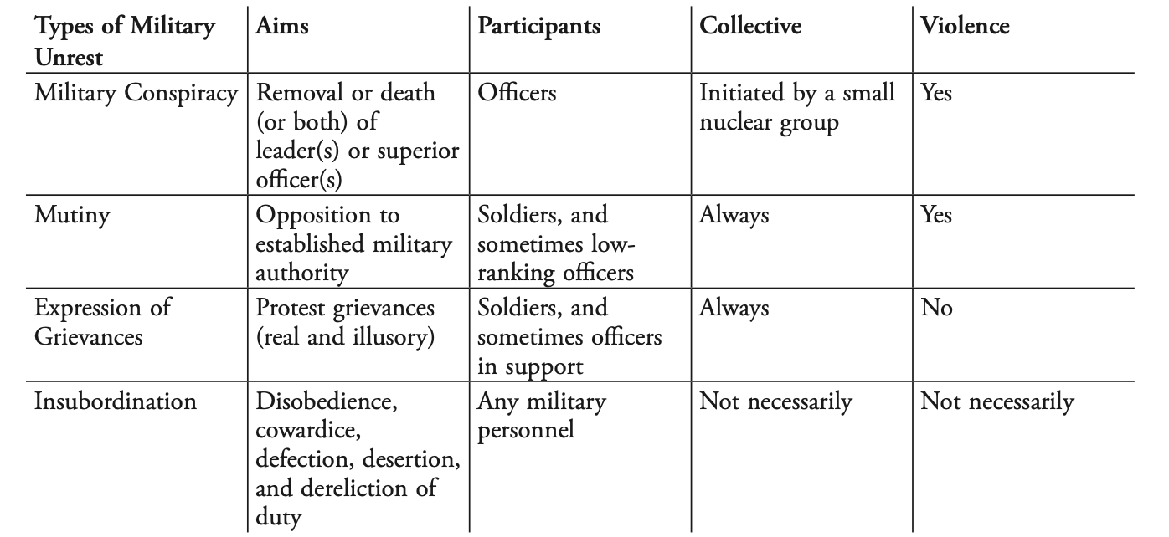
From Brice, 2012 – Military Unrest in the Age of Philip and Alexander

Slide 15
Events: Summer 325 – 323 BCE
The “Exiles’ Decree” (4th of August, 324)
At the Olympic games, Alexander had it announced that all Greek cities had to accept the return of political exiles (except those guilty of murder).
A strong contradiction of both the laws and spirit of the league of Corinth, and autonomy of Greek city-states.
There were both many exiles at Alexander’s court lobbying for their return, and many entire communities (notably Samos, entirely exiled by the Athenians decades earlier)
An act of an autocratic benefactor; but Diodorus (18.8.2) also notes that with the Exiles’ decree, Alexander would be installing his own partisans in many cities as a check on any revolutionary tendencies.
The decree was backed by the force of Antipater’s army; also likely aimed at breaking up Athenian and Aetolian federated power.
The politics of the decree are complex, but the crucial point is that it shows Alexander treating the Greek cities very differently than when he had departed, no political negotiations, but royal decrees.
The Death of Hephaestion (October 324)
- While holding festivities at Ecbatana, Hephaestion became sick and died.
Arrian (7.14) relates that there are many different accounts of how A. grieved for Hephaestion, but all agree that it was intense.

Slide 16
Events: Summer 325 – 323 BCE
What was Next?
Arrian 7.1: “After reaching Pasargadae and Persepolis Alexander was seized with a longing to sail down the Euphrates and Tigris to the Persian Sea, and to see the outlets of the rivers into the sea, like that of the Indus, and the sea in that region. Some have also recorded that Alexander was planning to sail round most of Arabia, Ethiopia, Libya and the Nomads beyond Mount Atlas, Gadeira [Cadiz] and into our sea and, after subduing Libya and Carthage, finally to earn the title of king of all Asia; as for the Persian and Median kings, in his view they had not ruled even a fraction of Asia, and so had no right to call themselves Great Kings. Thereafter, in some accounts, he planned to sail into the Euxine [Black] Sea to Scythia [Russia] and Lake Maeotis [Sea of Azov], in others to make for Sicily and the Iapygian promontory [Capo S. Maria di Leuca], as he was already rather disturbed that Rome’s fame was advancing to a great height.”

Slide 17
The Death of Alexander: June 10/11, 323 BCE
*One of the greatest problems in Alexander’s history is his death Babylon (precisely dated via Babylonian Astronomical Diary):
Certainties:
Alexander died in Babylon after a period of ~10 days of increasing illness, following a drinking party hosted by Medius.
Sources unanimous in reporting that a variety of omens preceded Alexander’s death, but not unanimous in which omens (Arrian, Plutarch, Diodorus, and Justin all report that Chaldaean seers warned Alexander not to enter Babylon based on an oracle in Spring 323).
Rumors of poisoning certainly circulated after Alexander’s death; but most of our main sources dismiss them (The most prevalent story, at Arrian 7.27.1-2, Plutarch 77, was that Antipater and his sons Cassander/Iolaus were prime suspects, which was certainly going around by 317).
*Both Arrian and Plutarch cite (for the first time) as a source the Royal Diaries (Ephemerides) as an account for Alexander’s illness and final days.
The diaries seem trustworthy, unless they were specifically written to refute rumors of poisoning.
The cause of Alexander’s death is also hopelessly entwined with the later struggles between factions after his death (Antipater and Cassander accused later by Perdiccas, Olympias)

Slide 18
The Death of Alexander: June 10/11, 323 BCE
*Bosworth (1971), highlighting that rumors of poisoning close after Alexander’s death should be taken seriously, and dismissing the Ephemerides (since they aren’t used as a source elsewhere), argues that the poisoning theory is likely:
Ephemerides cited differently by Arrian and Plutarch
Ephemerides mention a temple of Serapis in Babylon, but this is a feature of Ptolemaic Egypt.
Thus the Ephemerides might be early propaganda, and successively altered in the source tradition: Likely composed by Eumenes of Cardia, before the breakdown between Antipater and Perdiccas in 322/321.
There must have been hostility between Alexander and Antipater: Olympias had been actively hostile since 330, and Craterus was being sent back to Macedonia to replace him. Hence the embassy from his son Cassander in 323.
Many scientists have attempted to examine the evidence for cause of death, with many incompatible theories put forward: none have found strong evidence of poisoning, but none have found a single convincing natural cause either.
Q) Is this question impossible to penetrate? If not, what insights might come from the attempt?

Slide 19
Last Plans and Succession
When Alexander died, his first wife Roxane was still pregnant with the future Alexander IV; his brother Philip Arrhidaeus (soon Philip III) was not capable of ruling himself.
There are two main accounts of Alexander’s final words/actions before his death. Arrian (7.26.3) states explicitly that neither Aristobulus or Ptolemy mention either:
When asked by companions who he would leave his kingdom to: “To the strongest”.
-> The consequences of this statement are made clear by the addition that A. foresaw “great funeral games” following his death (i.e. conflict; Arrian 7.26.3; Diodorus 18.1).
In some accounts (Diodorus 17.117.3; QC 10.5.4), A. hands his signet ring to Perdiccas (effectively the 2nd in command and most influential of the generals).
-> These two acts would not be contradictory; the ring would signify management of royal affairs on an interim basis, at most a regency.
Q) Why would Alexander foresee, and accept, the inevitable conflict that would follow his death? What precedents made this inevitable?

Slide 20
The Funeral Games Begin
Two factions emerged soon after Alexander’s death:
Perdiccas, acting as regent over the unborn child, along with the Macedonian elite and cavalry
Meleager, on behalf of the infantry and supporting Philip Arrhidaeus
Meleager seems to have drawn on conservative elements and resistance to Alexander’s ‘Persianizing’ policies. An element of class conflict in the army?
But Meleager’s faction quickly broke down, and a reconciliation was effected with Perdiccas serving as regent over Philip and the future Alexander, who would rule as co-kings.
At the “Partition of Babylon”, satrapies were designated. Most significantly, Ptolemy was granted Egypt by request.
323/322: The Lamian War (Athens and coalition of Greek cities rebel)
In 321, power-grabs were already under way: Antipater/Craterus/Antigonus prepared for war against Perdiccas; Perdiccas took an army to Egypt against Ptolemy, but was killed in a mutiny in his camp.
Another partition in 320, at Triparadeisos: Antipater as regent over the co-rulers, and Seleucus ascends to Babylonia.

